Slide 1
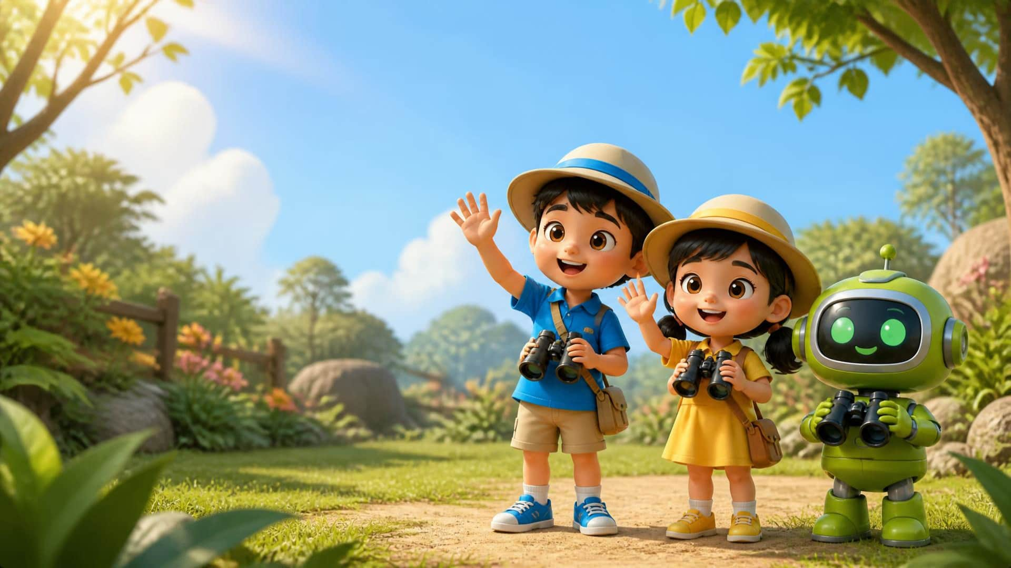

1 / 13
LESSON 10 - BLUE HUNT & WEEK 2 REVIEW
Welcome to Review Day!
Hello!
Review Time!
TEACHER • TPR
LITTLE SEEDS! MONTH 1

Slide 2
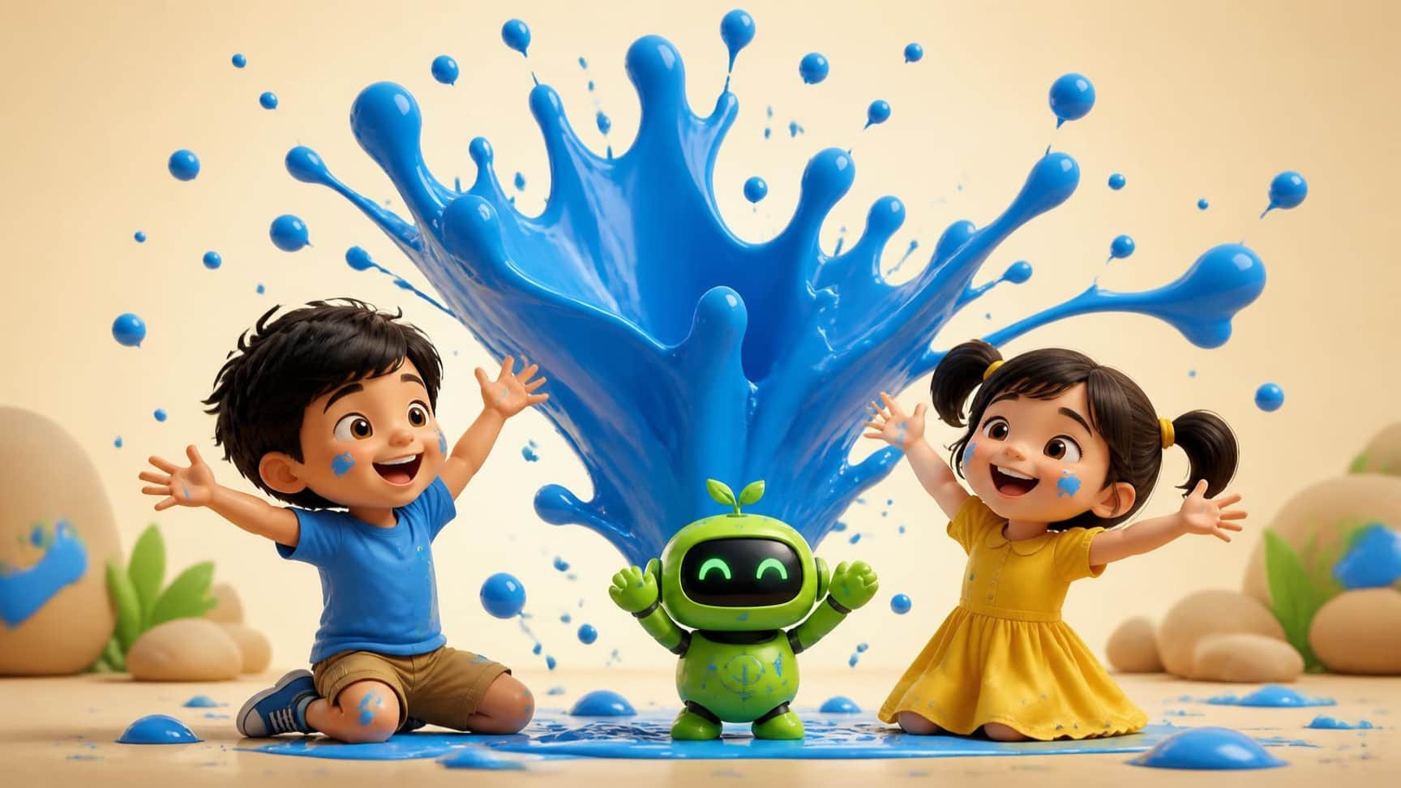
Lesson 10 – Blue Hunt & Week 2 Review
2 / 13
Color Review: Blue
Blue
TEACHER • TPR
What color is this? [Pause, point to screen] Yes! It is Blue! Let me hear you say BLUE! [Cup ear]
LITTLE SEEDS! MONTH 1

Slide 3
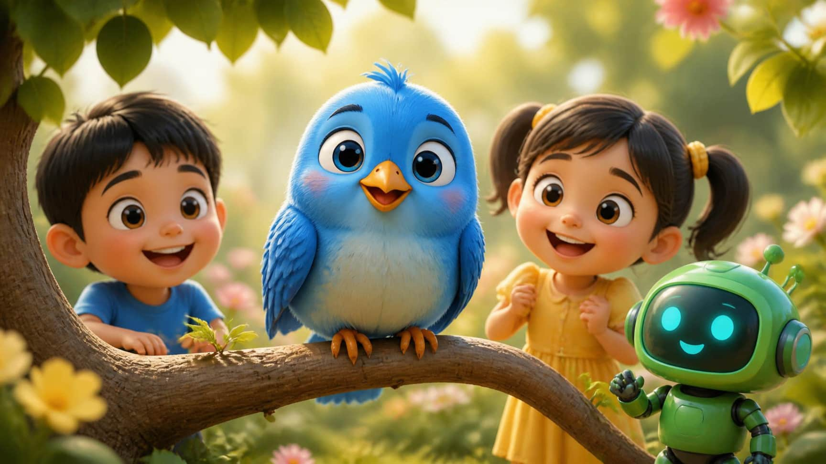
Lesson 10 – Blue Hunt & Week 2 Review
3 / 13
Word Review: Bird
Bird
TEACHER • TPR
Who is this? [Point to screen] Listen: Bird. Say: Bird! [Cup ear] What color is the bird? It is blue!
LITTLE SEEDS! MONTH 1

Slide 4
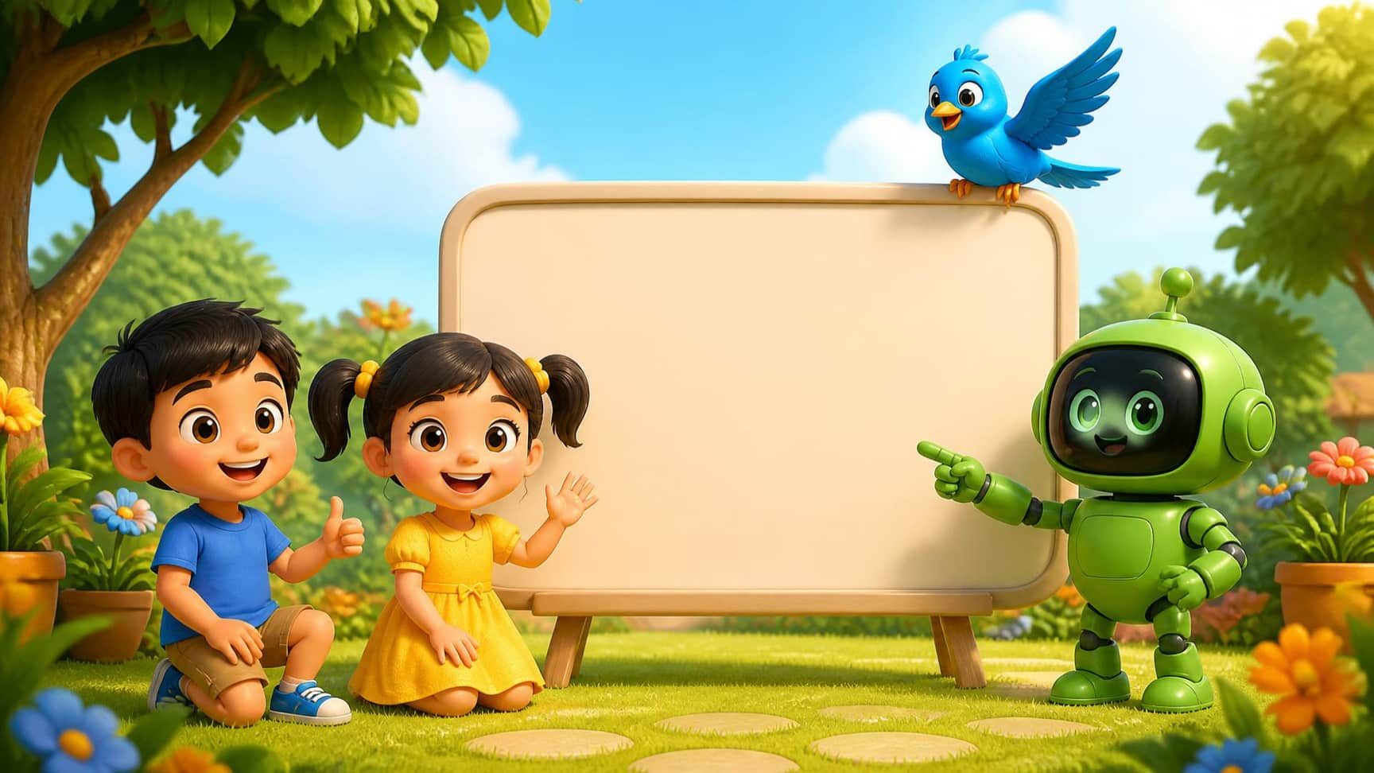
Lesson 10 – Blue Hunt & Week 2 Review
4 / 13
Phonics Review: Letter B
B b
Bb /b/ Bird
TEACHER • TPR
Do you remember this letter? It is B! [Trace B in air] What sound does it make? /b/ /b/ Bird! Say it with me: /b/ /b/ Bird!
LITTLE SEEDS! MONTH 1

Slide 5
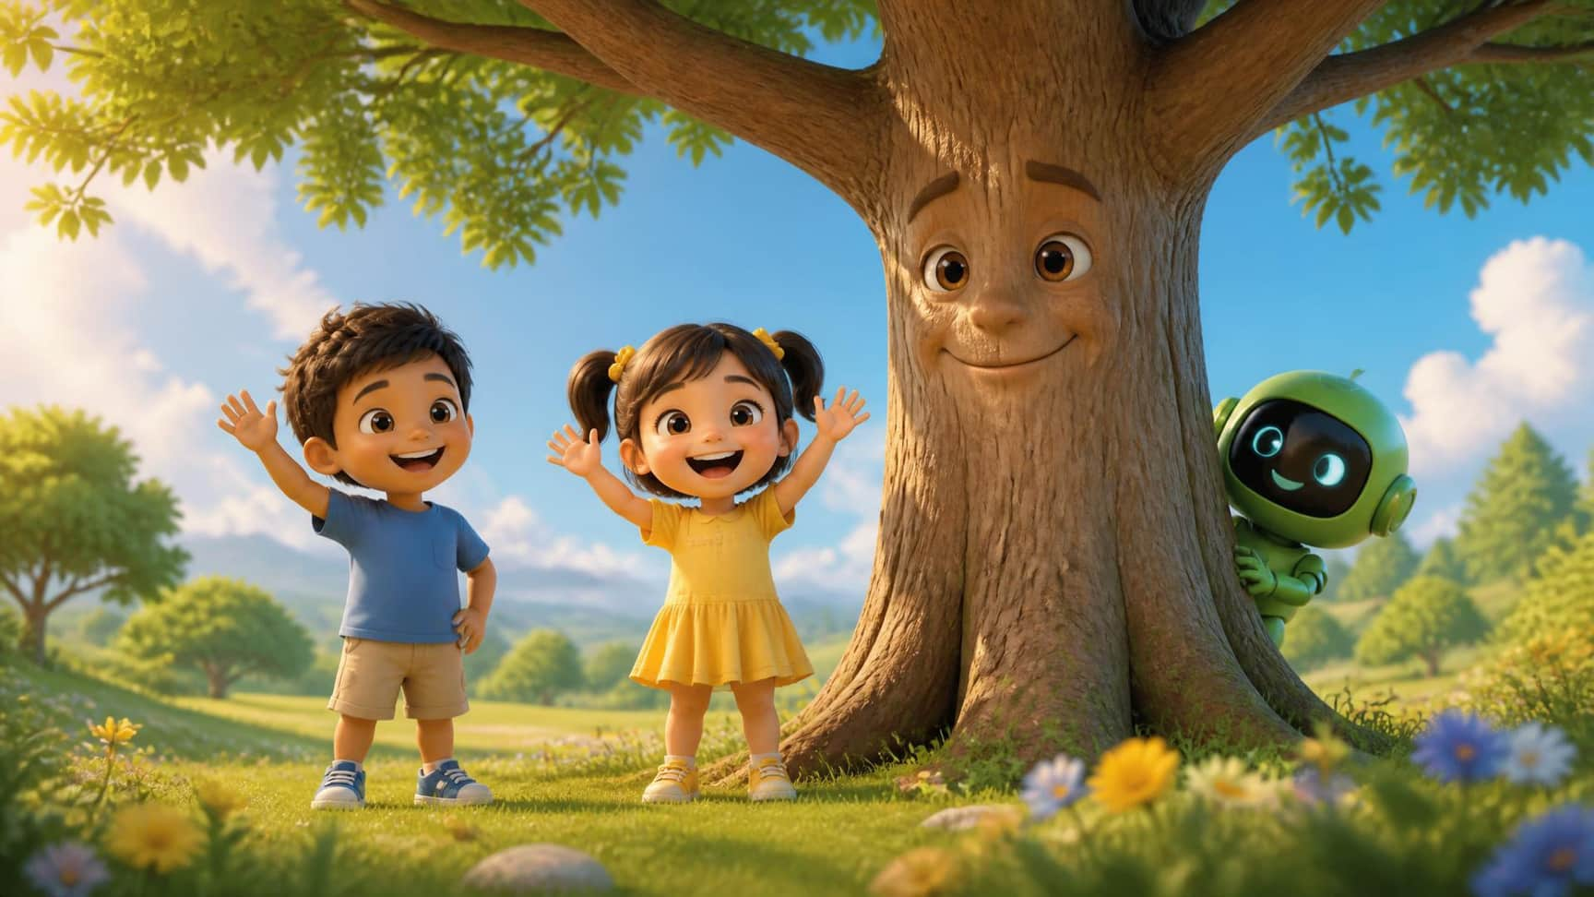
Lesson 10 – Blue Hunt & Week 2 Review
6 / 13
Action Review: Hello, Tree!
Hello, tree!
TEACHER • TPR
Trees are our friends. Let's say hello! [Wave hand wildly] Say: Hello, tree! [Wait for response]
LITTLE SEEDS! MONTH 1

Slide 6
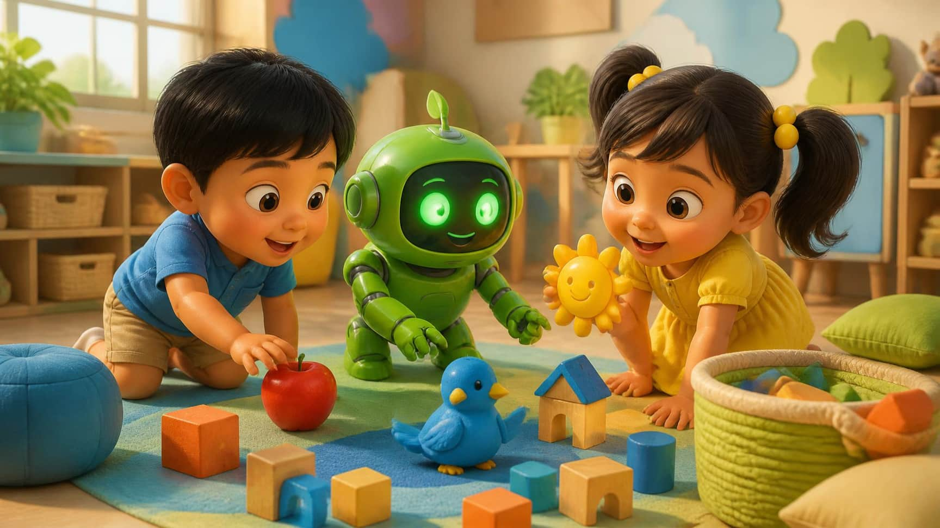
Lesson 10 – Blue Hunt & Week 2 Review
7 / 13
Game: The Blue Hunt
Find Blue!
TEACHER • TPR
Where is the blue toy? Touch something blue! [Wait for tap] Yes! The bird is blue!
LITTLE SEEDS! MONTH 1

Slide 7
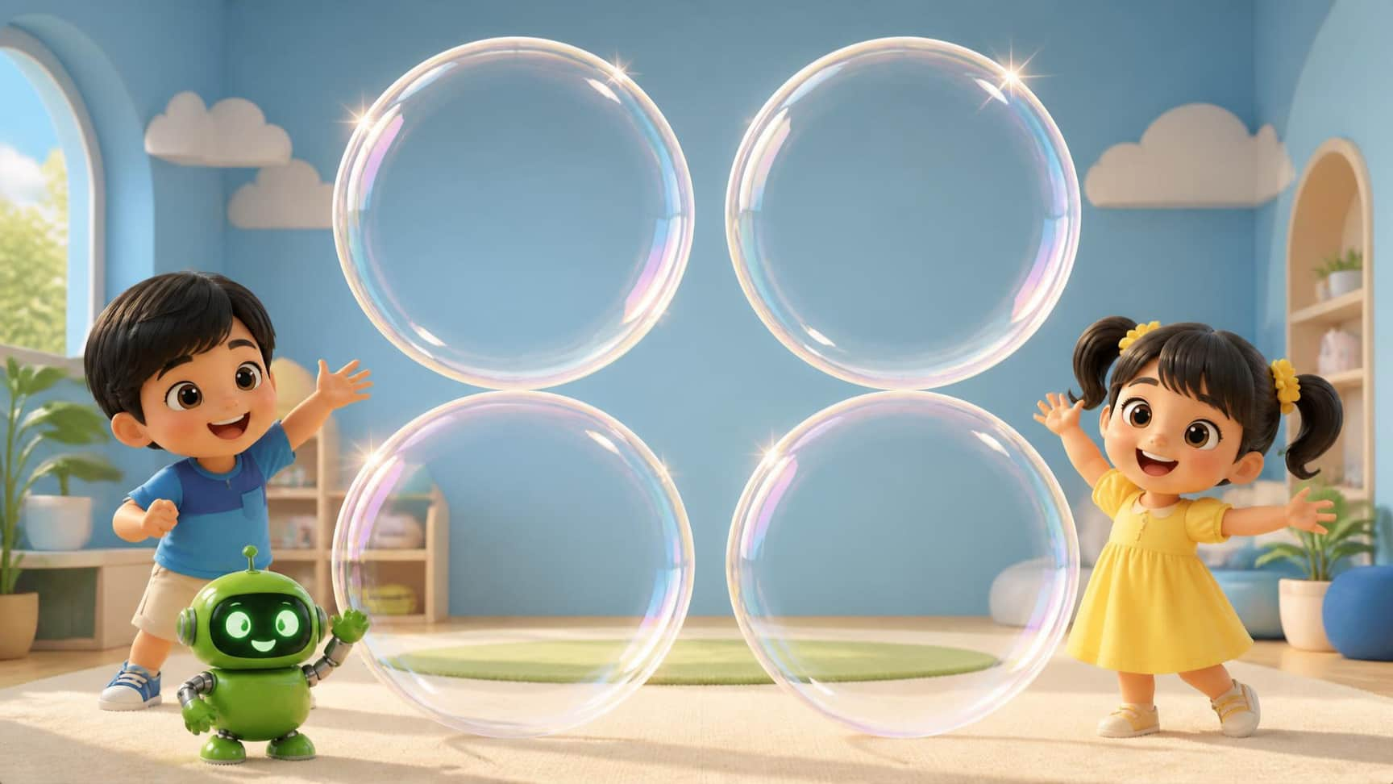
Lesson 10 – Blue Hunt & Week 2 Review
8 / 13
Game: Pop the B!
A
B
Pop the B!
A
B
TEACHER • TPR
Pop the bubbles! Only pop the letter B! Touch B! [Wait for taps] Pop! Pop! Great job!
LITTLE SEEDS! MONTH 1

Slide 8
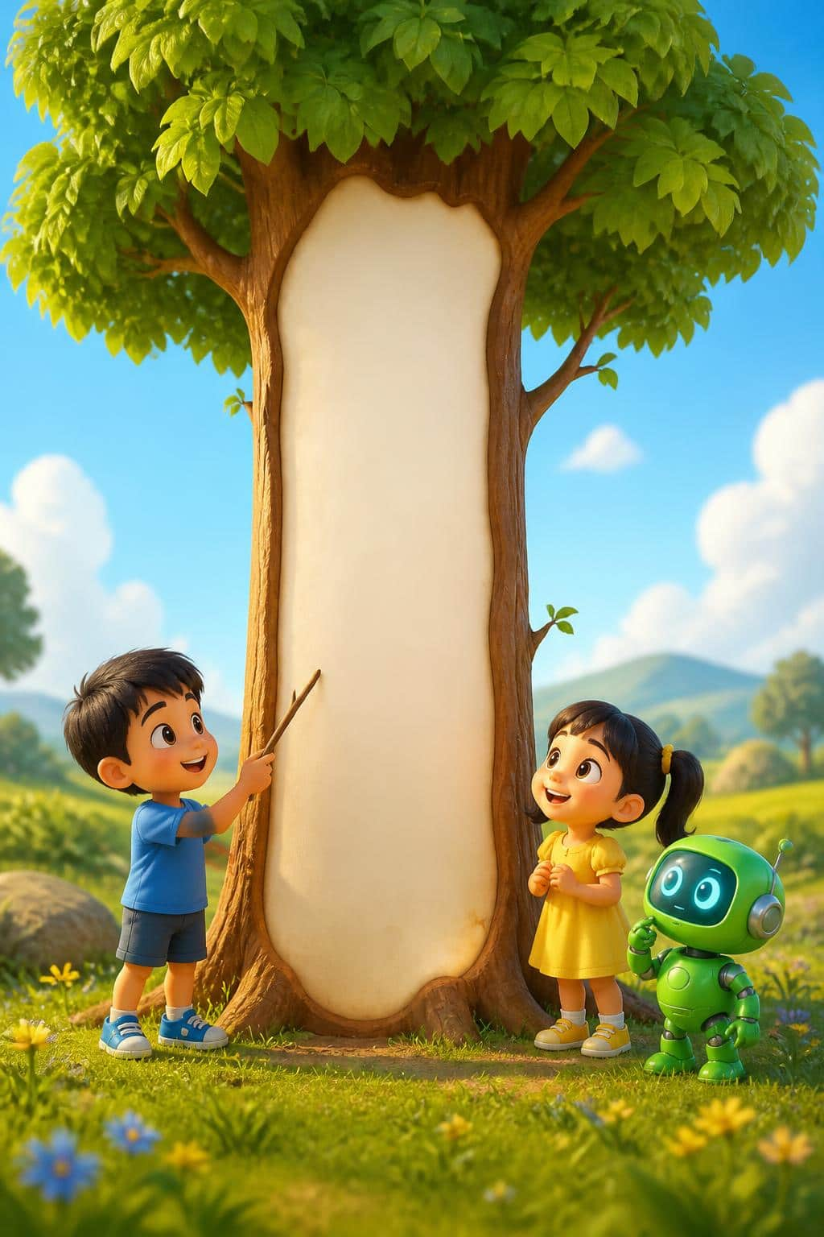
Lesson 10 – Blue Hunt & Week 2 Review
9 / 13
Game: Trace the Tall Tree
Draw down.
TEACHER • TPR
Magic finger ready! Let's draw the tall tree. Down, down, down! [Trace vertically on screen]
LITTLE SEEDS! MONTH 1

Slide 9
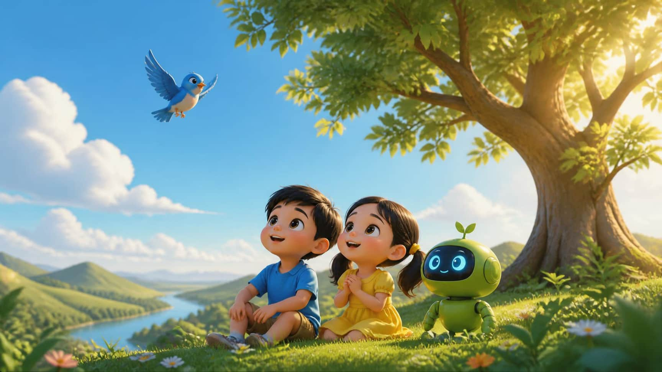
Lesson 10 – Blue Hunt & Week 2 Review
10 / 13
Christian Value Integration
God made our world.
TEACHER • TPR
Who made the blue sky and the tall trees? God did! God made our beautiful world. [Smile warmly and clasp hands]
LITTLE SEEDS! MONTH 1

Slide 10
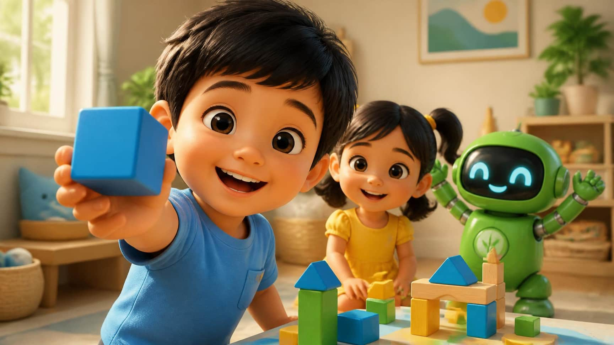
Lesson 10 – Blue Hunt & Week 2 Review
11 / 13
Real World Connection Scavenger Hunt
Your turn! Find blue!
TEACHER • TPR
Quick! Stand up! Find something blue in your house! Bring it to the camera! [Cheer loudly when they return with an object]
LITTLE SEEDS! MONTH 1

Slide 11
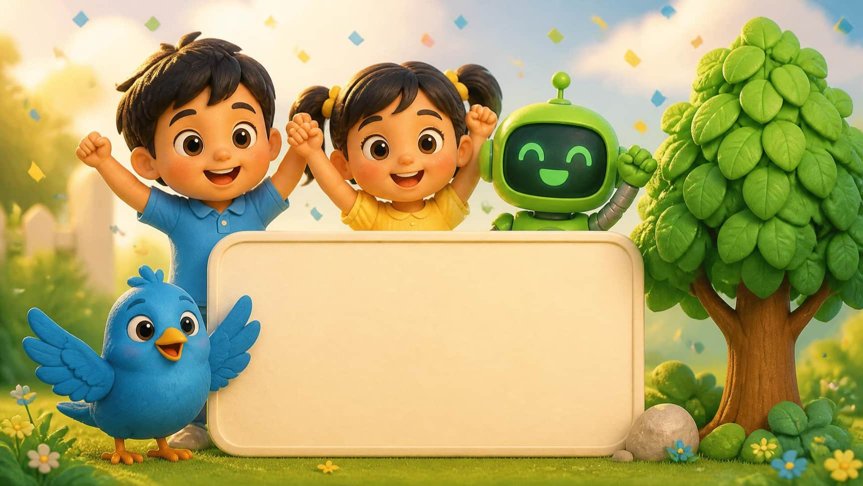
Lesson 10 – Blue Hunt & Week 2 Review
12 / 13
Lesson Review
B
You did it!
BLUE BIRD
LETTER B
TALL TREE
TEACHER • TPR
You are a star! Say: Blue Bird! Say: Letter B! Say: Tall Tree! Amazing!
LITTLE SEEDS! MONTH 1

Slide 12
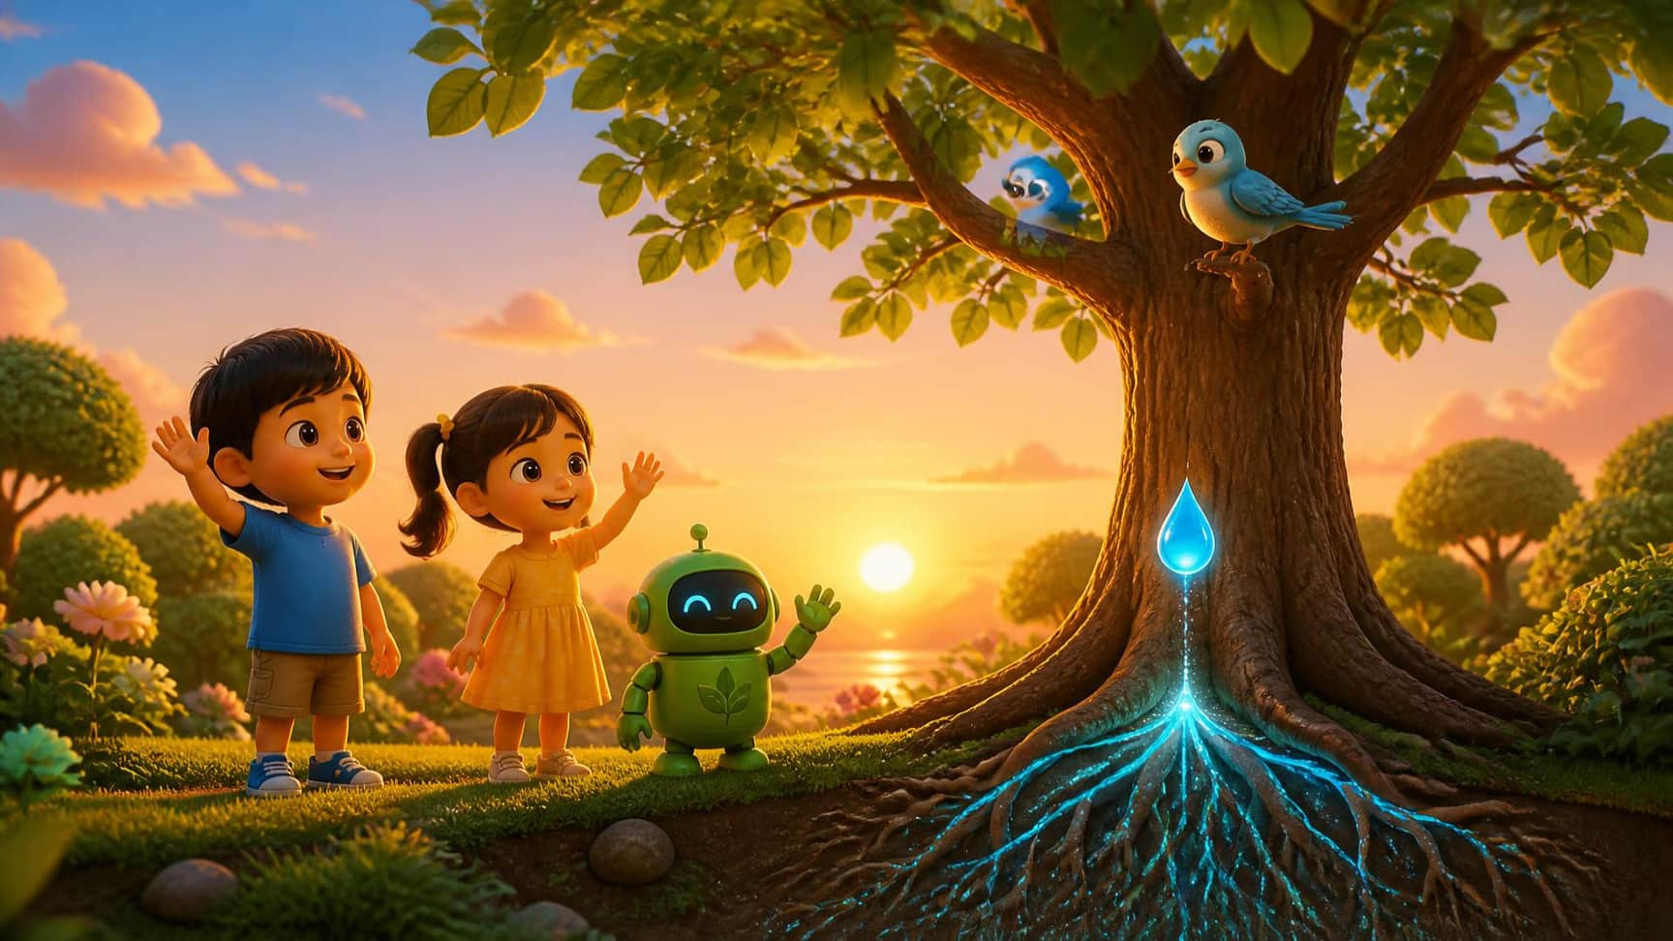
Lesson 10 – Blue Hunt & Week 2 Review
13 / 13
Goodbye & Virtual Garden Reward
Goodbye!
TEACHER • TPR
An Eco-Drop for you! Look, the blue bird loves your tall tree! Goodbye, see you next week! [Wave]
LITTLE SEEDS! MONTH 1

